Slide 1
Topics
Access Modifiers Overview
Wrapper classes
Auto-boxing / Auto-unboxing
String, String Buffer
Exception Handling.

Slide 2
Access Modifiers Overview
Variables and methods can be at one of the four access levels :
    public, protected, default, private
  A variable, method or class has default accessibility if it does not have an explicit protection modifier declared
  Outer classes can only have ‘public’ or ‘default’ access and can have qualifiers like ‘ final / abstract, ‘strictfp‘
  Inner classes can be ‘public’, ‘protected’ , ‘private’, ‘default’ as access specifiers
  A protected method or variable is accessible from methods in classes that are in the same package and any method in any subclass

Slide 3
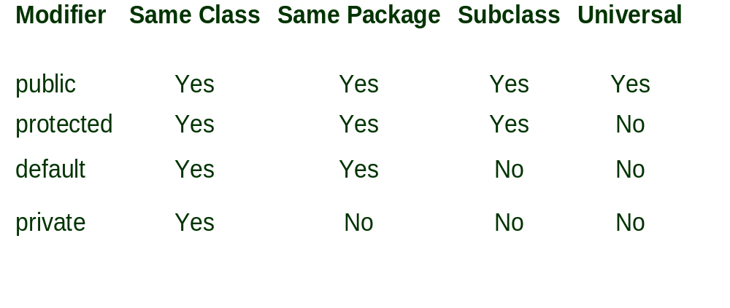
Access Modifier Overview

Slide 4
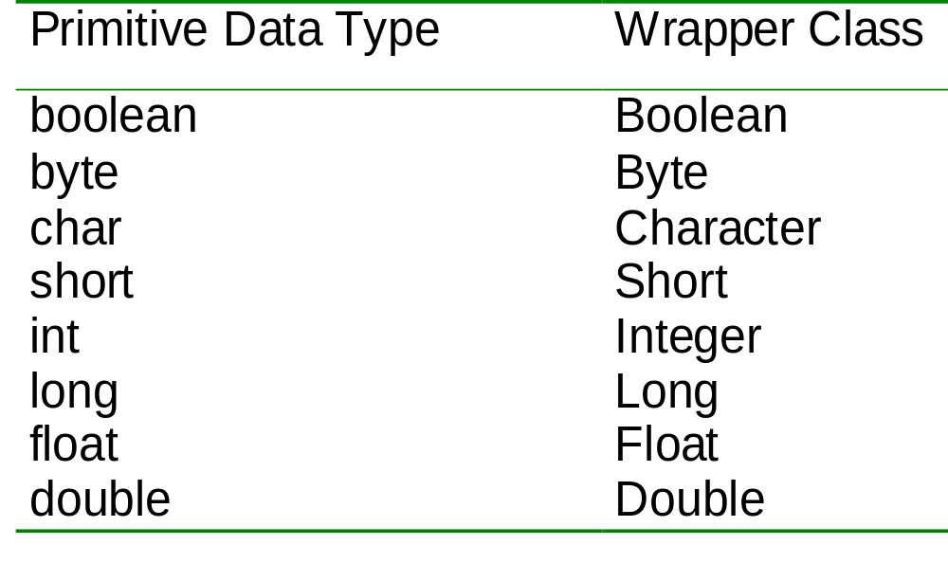
Wrapper classes

Slide 5
Wrappers are immutable
The heap
11
10
Stack Memory
intObj
intObj
main

Slide 6
What is an Exception
An event during program execution that prevents the program from continuing normally
An error condition that changes the normal flow of control in a program
A signal that some unexpected condition has occurred in the program

Slide 7
Handling exception in Java
Exception mechanism is built around the throw-and-catch paradigm
  “to throw” means an exception has occurred
  “to catch” means to deal with an exception
If an exception is not caught, it is propagated to the call stack until a handler is found
Propagating an exception is called “ducking” the exception, or “passing the buck”

Slide 8
Types of Exceptions
All exceptions in Java are objects of Throwable class
Unchecked Exceptions
  are exceptions derived from Error and RuntimeException classes
  are usually irrecoverable and not handled explicitly
  are not checked by the compiler
Checked Exceptions
  are exceptions derived from Exception class excluding the RuntimeException class
  must be handled explicitly
  are checked by the compiler
Both checked and unchecked exceptions can be thrown and caught
New exceptions are created by extending the Exception class or its subclasses

Slide 9
Exception Hierarchy
Throwable
Error
Exception
...
RuntimeException
InterruptedException
IOException
...
ArithmeticException
...
...
NullPointerException
...
Unchecked Exceptions
Checked Exceptions

Slide 10
try-catch-finally
try block encloses the context where a possible exception can be thrown
try {
/*
* some codes to test here
*/
} catch (Exception1 ex) {
/*
* handle Exception1 here
*/
} catch (Exception2 ex) {
/*
* handle Exception2 here
*/
} catch (Exception3 ex) {
/*
* handle Exception3 here
*/
} finally {
/*
* always execute codes here
*/
}
each catch() block is an exception handler and can appear several times
Exception1 should not shadow Exception2 which in turn should not shadow Exception3 (based on the exception hierarchy)
finally block is always executed before exiting the try statement. finally block is optional but must appear once after the catch() blocks
at least one catch() block or finally block must appear in the try statement

Slide 11
Unhandled Exceptions
public class GradingSystem {
public static void main(String[] args) {
GradingSystem gs = new GradingSystem();
gs.checkGrades();
}
void checkGrades() {
int[] grades=null;
for (int i=0; i<grades.length; i++) { /* test here*/ };
}
}
Exception in thread "main" java.lang.NullPointerException
at codesnippets.GradingSystem.checkGrades(GradingSystem.java:31)
at codesnippets.GradingSystem.main(GradingSystem.java:6)

Slide 12
Handling Exceptions
public class GradingSystem {
public static void main(String[] args) {
GradingSystem gs = new GradingSystem();
gs.checkGrades();
}
void checkGrades() {
int[] grades=null;
try {
for (int i=0; i<grades.length; i++) { /* test here*/ };
} catch (NullPointerException e) {
System.out.println("Grades may be empty!");
} catch (RuntimeException e) {
System.out.println("Problem while executing!");
} catch (Exception e) {
System.out.println("Error in checking grades!");
} finally {
System.out.println("Finished checking grades.");
}
}
}

Slide 13
throw and throws
throws clause declares the unhandled exceptions that a method can throw. It propagates the exception to the calling method. It becomes part of the method public interface
void validate() throws Exception3 {
try {
// throw an exception
throw new Exception3();
} catch (Exception1 ex) {
/*
* handle Exception1 here
*/
} catch (Exception2 ex) {
/*
* handle Exception2 here
*/
} catch (Exception3 ex) {
/*
* can't handle Exception3,
* propagate to call stack
*/
throw new Exception3(ex);
}
}
Any code that calls this method must handle the exception declared in the throws clause
throw statement explicitly throws an exception
throw statement propagates (rethrows) a caught exception

Slide 14
Propagating Exceptions
public class GradingSystem {
public static void main(String[] args) {
GradingSystem gs = new GradingSystem();
try {
gs.checkGrades();
} catch (Exception e) { // must handle the exception thrown
System.out.println(e.getMessage());
}
}
void checkGrades() throws Exception {
int[] grades={81,0,75};
try {
for (int i=0; i<grades.length; i++) {
if (grades[i]<=0)
throw new Exception("Invalid grade!"); }
} catch (NullPointerException e) {
System.out.println("Grades may be empty!");
} catch (RuntimeException e) {
System.out.println("Problem while executing!");
} catch (Exception e) {
System.out.println("Can't handle error here! Rethrowing...");
throw new Exception(e);
}
}}
Can't handle error here! Rethrowing...
java.lang.Exception: Invalid grade!

